Slide 1

The Sole Trader vs. Limited Company Decision Guide
Understanding key differences for informed business choices
Notes:
---

Slide 2
Introduction
Notes:
Why this decision matters

Slide 3

Why this decision matters
Tax and Liability Differences
  Sole traders face higher personal tax rates and unlimited liability, while limited companies have tax planning benefits and limited liability protection.
Control versus Compliance
  Sole traders enjoy simplicity and direct control, whereas limited companies involve more administrative tasks and compliance costs.
Alignment with Business Goals
  Choosing the right structure depends on financial goals, risk tolerance, and long-term strategy for growth.
Notes:
Choosing between Sole Trader and Limited Company status is one of the most important decisions for UK contractors and small businesses. This choice has far-reaching implications on how your business is taxed, the level of personal liability you assume, and your potential for growth. Sole traders benefit from simplicity and direct control, but they also face unlimited personal liability and higher personal tax rates. On the other hand, operating as a Limited Company offers limited liability protection and tax planning opportunities, but comes with increased administrative responsibilities and compliance costs. Understanding these differences is crucial for making an informed decision that aligns with your financial goals, risk tolerance, and long-term business strategy.

Slide 4
Comparison Overview
Notes:
Key structural differences

Slide 5
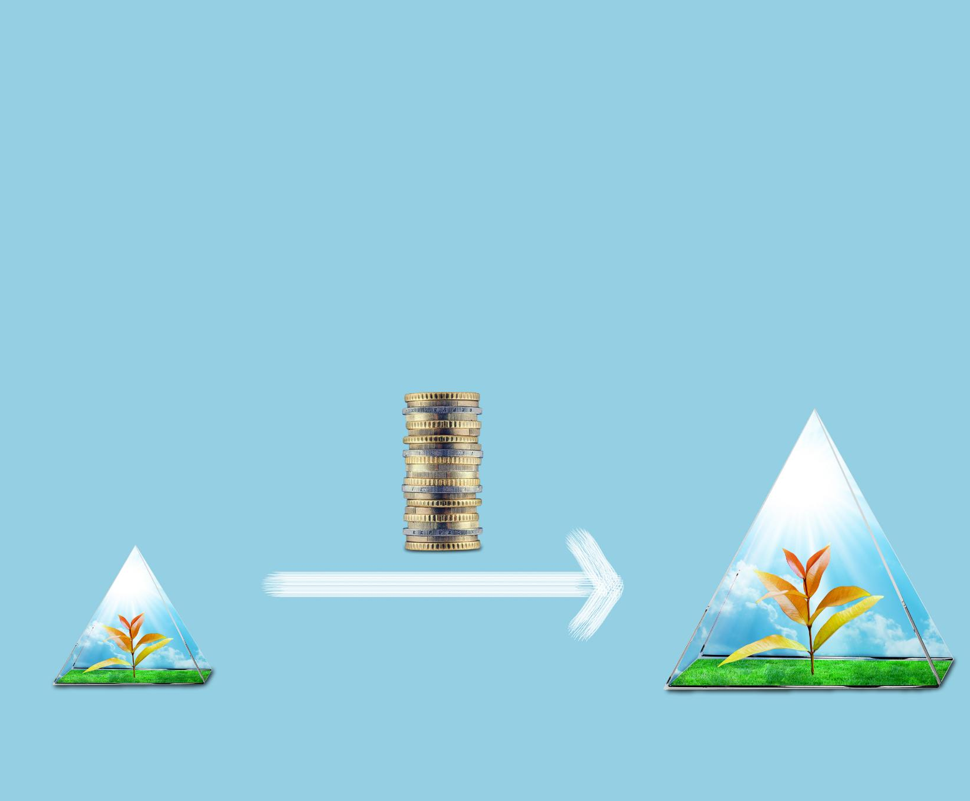
Key structural differences
Sole Trader Structure
  A sole trader is an individual operating the business, with personal liability for all debts.
Limited Company Structure
  A limited company is a separate legal entity, providing limited liability protection to its shareholders.
Legal and Financial Implications
  Limited companies require registration and corporate governance, enhancing credibility and investor appeal.
Notes:
The fundamental difference between a Sole Trader and a Limited Company lies in their legal and financial structure. A Sole Trader operates as an individual, meaning the business and the owner are legally the same entity. This setup is straightforward and requires minimal paperwork, but it also means the owner is personally liable for all business debts. In contrast, a Limited Company is a separate legal entity from its owners (shareholders), offering limited liability protection. This structure requires registration with Companies House and adherence to corporate governance rules, but it enhances credibility and can be more attractive to clients and investors. Understanding these structural differences helps clarify the responsibilities and protections each option provides.

Slide 6
Tax Implications
Notes:
How each structure is taxed

Slide 7

How each structure is taxed
Sole Trader Taxation
  Sole Traders pay Income Tax on profits via self-assessment and also pay Class 2 and Class 4 National Insurance contributions.
Limited Company Taxation
  Limited Companies pay Corporation Tax on profits, currently around 19%, depending on profit levels, offering a different tax structure.
Profit Extraction Methods
  Directors extract profits as salary and dividends, with dividends taxed at lower rates and not subject to National Insurance.
Tax Efficiency Benefits
  Limited Companies have flexibility to optimize tax liabilities, especially beneficial for higher earners by combining salary and dividends.
Notes:
Taxation is a major factor in deciding between Sole Trader and Limited Company status. Sole Traders pay Income Tax on all profits through the self-assessment system, which can result in higher tax rates as income increases. They also pay Class 2 and Class 4 National Insurance contributions. Limited Companies, however, pay Corporation Tax on profits, currently set at 19% or higher depending on profit levels. Directors can then extract profits through a combination of salary and dividends, which may be more tax-efficient. Dividends are taxed at lower rates and are not subject to National Insurance. This flexibility in profit extraction allows Limited Companies to optimize tax liabilities, especially for higher earners.

Slide 8
Liability and Risk
Notes:
Personal vs. corporate liability

Slide 9

Personal vs. corporate liability
Personal Liability for Sole Traders
  Sole traders are fully responsible for all business debts and legal issues, putting personal assets at risk.
Limited Liability Protection
  Limited companies protect shareholders’ personal assets by limiting liability to company debts and obligations.
Legal Separation Benefits
  The legal separation between owners and company reduces personal financial risk and offers peace of mind.
Notes:
Liability is a critical consideration when choosing a business structure. Sole Traders are personally liable for all business debts and legal obligations, meaning personal assets are at risk if the business fails or faces litigation. This can be a significant concern for those operating in high-risk industries. In contrast, Limited Companies offer limited liability protection, meaning the company itself is responsible for its debts and obligations. Shareholders' personal assets are generally protected, provided there is no fraud or personal guarantees involved. This legal separation provides peace of mind and is often a deciding factor for entrepreneurs seeking to mitigate personal financial risk.

Slide 10
Administrative Responsibilities
Notes:
Compliance and reporting requirements

Slide 11

Compliance and reporting requirements
Sole Traders' Simplicity
  Sole Traders manage minimal paperwork with just an annual self-assessment tax return, easing independent business management.
Complex Compliance for Companies
  Limited Companies face multiple compliance tasks like filing annual accounts, confirmation statements, and maintaining registers.
Need for Professional Support
  Professional accounting support is often required for Limited Companies, adding to operational costs.
Benefits of Compliance
  Compliance promotes financial discipline and transparency, aiding long-term growth and investor confidence.
Notes:
Administrative responsibilities vary significantly between Sole Traders and Limited Companies. Sole Traders benefit from minimal paperwork, primarily needing to file an annual self-assessment tax return. This simplicity makes it easier to manage the business independently. Limited Companies, however, face more complex compliance requirements. They must file annual accounts, submit confirmation statements to Companies House, maintain statutory registers, and comply with payroll and dividend regulations. These tasks often necessitate professional accounting support, adding to operational costs. While the administrative burden is higher, it also enforces financial discipline and transparency, which can be beneficial for long-term growth and investor confidence.

Slide 12
Profit Extraction and Flexibility
Notes:
How profits are accessed and taxed

Slide 13

How profits are accessed and taxed
Sole Trader Profit Taxation
  Sole Traders pay tax on all profits as personal income, offering full control but potentially higher tax liabilities.
Limited Company Profit Extraction
  Limited Companies use salaries and dividends to extract profit, enabling strategic tax planning and savings.
Tax Planning and Compliance
  Effective profit extraction requires compliance with tax rules to avoid penalties and maximize savings.
Notes:
Profit extraction methods differ between Sole Traders and Limited Companies. Sole Traders retain all profits and pay tax on them as personal income. This straightforward approach offers full control but can lead to higher tax liabilities. Limited Companies, on the other hand, allow for strategic profit extraction through salaries and dividends. Directors can pay themselves a low salary to minimize National Insurance contributions and take the remainder as dividends, which are taxed at lower rates. This flexibility enables better tax planning and can result in significant savings. However, it requires careful management and compliance with HMRC rules to avoid penalties.

Slide 14
Perception and Growth Potential
Notes:
Impact on branding and scalability

Slide 15

Impact on branding and scalability
Business Perception Effects
  Sole Traders may be seen as small-scale, limiting appeal to large clients and investors critical for growth.
Professional Image of Limited Companies
  Limited Companies project stability and professionalism, enhancing credibility and attracting better clients.
Scalability and Investment
  Limited Companies can issue shares and bring investors, facilitating expansion and partnerships.
Notes:
The perception of your business structure can influence client trust and growth opportunities. Sole Traders may be viewed as small-scale operations, which can limit their appeal to larger clients or investors. This perception may affect the ability to secure contracts or funding. Limited Companies, by contrast, project a more professional image and are often seen as more stable and scalable. This can enhance credibility, attract better clients, and open doors to investment and partnerships. Additionally, Limited Companies can issue shares and bring in co-founders or investors, facilitating expansion. Choosing the right structure can therefore impact not just operations but also market positioning and future growth.

Slide 16
Pros and Cons
Notes:
Sole Trader: Advantages and disadvantages, Limited Company: Advantages and disadvantages

Slide 17

Sole Trader: Advantages and disadvantages
Advantages of Sole Trader
  Easy to set up with minimal administration and full control over business decisions.
Unlimited Personal Liability
  Sole traders face unlimited personal liability, risking personal assets if business debts occur.
Challenges in Growth
  May struggle to secure larger contracts or funding due to perceived lack of professionalism.
Notes:
Operating as a Sole Trader offers several advantages, including ease of setup, low administrative burden, and full control over business decisions. It is ideal for freelancers and small-scale entrepreneurs who prefer simplicity. However, the disadvantages include unlimited personal liability, which exposes personal assets to business risks, and potentially higher personal tax rates as income increases. Sole Traders may also face challenges in securing larger contracts or funding due to perceived lack of professionalism. These factors should be weighed carefully when deciding on the best structure for your business.

Slide 18

Limited Company: Advantages and disadvantages
Advantages of Limited Companies
  Limited liability protection and tax planning opportunities enhance business growth and credibility.
Disadvantages of Limited Companies
  Increased administrative tasks, compliance costs, and accounting requirements pose challenges.
Corporate Governance Responsibilities
  Directors must follow governance rules and carefully manage payroll and dividends.
Notes:
Limited Companies offer significant benefits, including limited liability protection, tax planning opportunities, and a professional image that can enhance credibility. They are well-suited for businesses with growth ambitions and those operating in higher-risk sectors. However, the disadvantages include increased administrative responsibilities, compliance costs, and the need for professional accounting support. Directors must adhere to corporate governance rules and manage payroll and dividend distributions carefully. Despite these challenges, the advantages often outweigh the drawbacks for businesses seeking scalability and financial efficiency.

Slide 19
Decision-Making Checklist
Notes:
Factors to consider before choosing

Slide 20

Factors to consider before choosing
Income Level
  Consider your expected income as higher earnings might benefit from Limited Company tax efficiencies.
Risk Tolerance
  Evaluate your risk tolerance; Limited Companies offer better protection against liabilities.
Growth Plans
  If planning to scale or attract investors, a Limited Company structure may be more suitable.
Compliance Requirements
  Understand compliance duties and decide if you can manage or need to outsource them.
Notes:
Before deciding between Sole Trader and Limited Company status, consider several key factors. Assess your expected income level, as higher earnings may benefit from the tax efficiencies of a Limited Company. Evaluate your risk tolerance—if your business involves significant liability, a Limited Company offers better protection. Consider your growth plans; if you aim to scale or attract investors, a Limited Company may be more suitable. Finally, understand the compliance requirements and whether you are prepared to manage or outsource them. This checklist helps ensure your decision aligns with your financial goals and operational capabilities.

Slide 21
Final Call to Action
Notes:
Encouragement to seek expert advice

Slide 22

Encouragement to seek expert advice
Importance of Expert Guidance
  Seeking advice from experts helps you understand tax, liability, and compliance complexities effectively.
Choosing the Right Business Structure
  Selecting between Sole Trader and Limited Company impacts your business’s future and legal standing.
Building a Strong Business Foundation
  Getting expert support ensures a solid foundation tailored to your specific business goals.
Notes:
Making the right decision between Sole Trader and Limited Company status can have lasting implications for your business. To ensure you choose the structure that best fits your needs, consider booking a free consultation with a business advisor or accountant. Expert guidance can help you navigate the complexities of tax, liability, and compliance, and tailor your setup to your specific goals. Don’t leave this critical decision to guesswork—get the support you need to build a strong foundation for your business.

